Slide 1


Consumer Goods
Ad-Hoc Insights

Slide 2
About the Company – AtliQ Hardwares
AtliQ Hardwares is a global computer hardware manufacturing company headquartered in India, offering products such as PCs, peripherals, and accessories.
Operates primarily on a B2B business model, supplying products to major retail stores and online platforms
Serves customers through a multi-channel strategy:
  Retailer Channel: Brick-and-Mortar stores and E-commerce platforms
  Direct Channel (B2C): Company-owned stores like AtliQ Exclusive and AtliQ E-Store
  Distributor Channel: Authorized distributors in restricted trade regions
Strong presence across multiple international markets
Focused on scalable growth and customer reach through diversified sales channels

Slide 3
Objective
Enable AtliQ Hardwares’ leadership to make timely, data-driven decisions by performing SQL-based ad-hoc analysis on sales, product, customer, and channel data.
The analysis focuses on understanding market reach, product portfolio growth, cost efficiency, sales trends, customer discounts, and channel performance across fiscal years.
Business Outcomes
Assessed regional market presence of key customers for strategic expansion
Measured year-over-year product growth and identified fast-growing segments
Highlighted top and bottom manufacturing cost products to support cost optimization
Analyzed customer discount patterns to improve pricing strategies
Delivered monthly and quarterly sales trend insights to identify seasonality
Identified the most profitable sales channel and its revenue contribution
Ranked top-performing products by division to guide sales and inventory focus

Slide 4
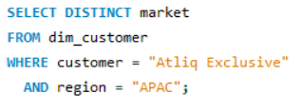
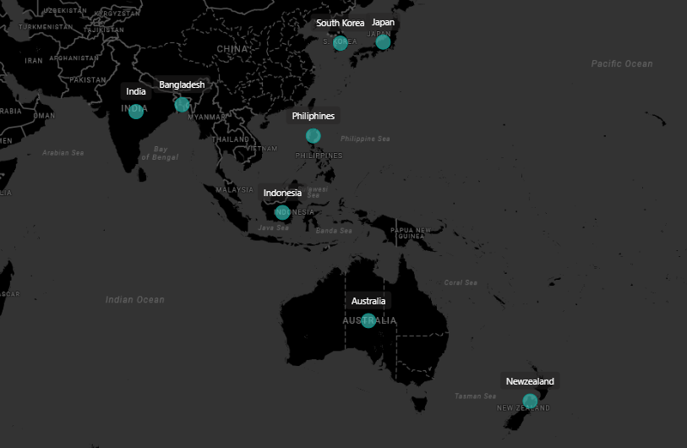
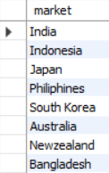
1. Provide the list of markets in which customer "Atliq Exclusive" operates its business in the APAC region.

Slide 5
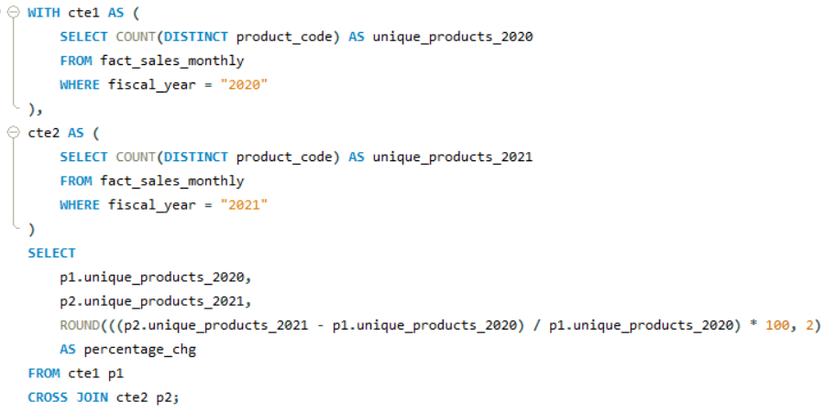
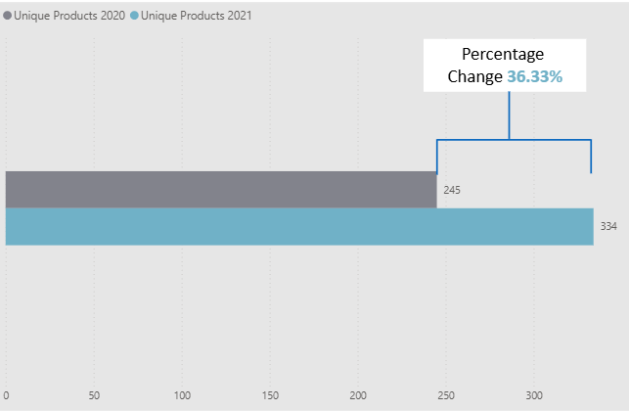

2. What is the percentage of unique product increase in 2021 vs. 2020?
Output Fields: unique_products_2020, unique_products_2021, percentage_chg

Slide 6
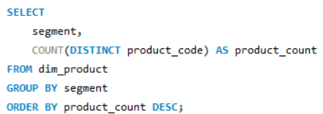
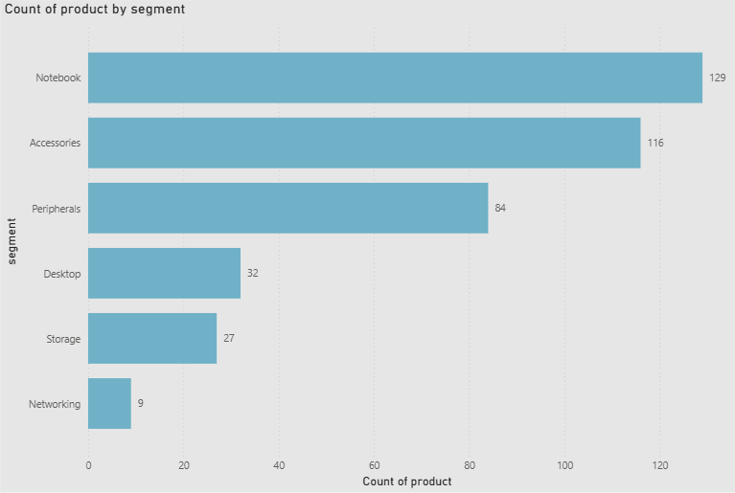
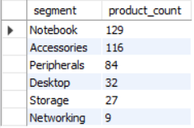
3. Provide a report with all the unique product counts for each segment and sort them in descending order of product counts.
Output Fields: segment, product_count

Slide 7
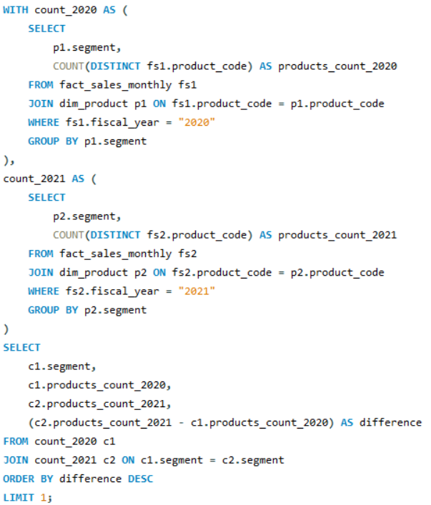
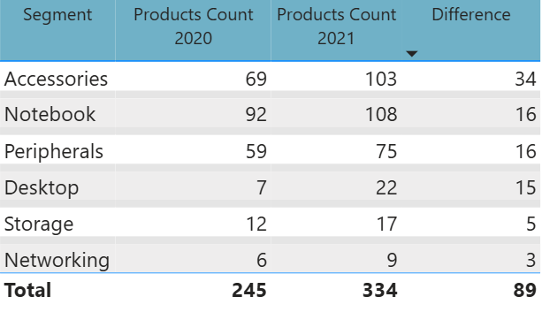
4. Which segment had the most increase in unique products in 2021 vs 2020?Output Fields: segment, product_count_2020, product_count_2021, difference

Slide 8
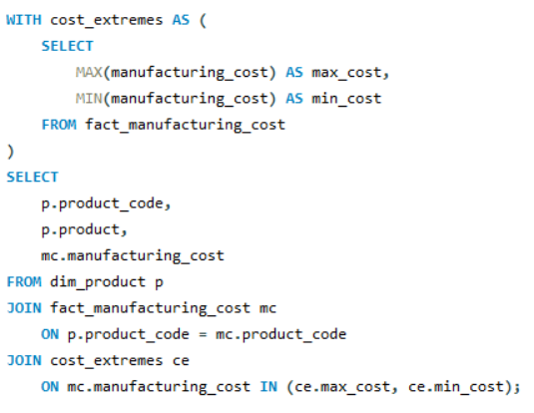
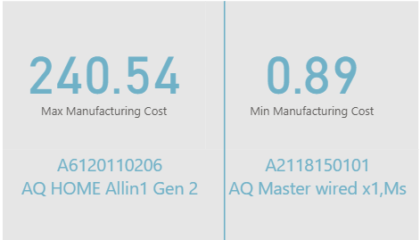

5. Get the products that have the highest and lowest manufacturing costs.
Output Fields: product_code, product, manufacturing_cost

Slide 9
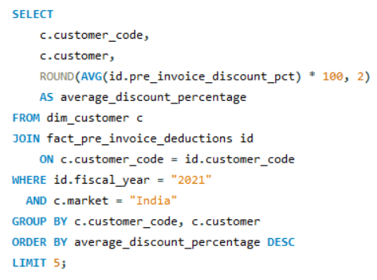
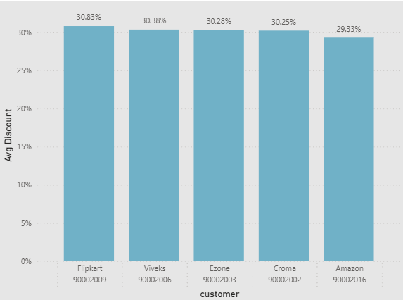
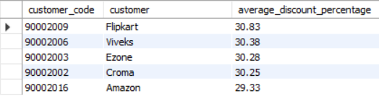
6. Generate a report which contains the top 5 customers who received an average high pre_invoice_discount_pct for the fiscal year 2021 and in the Indian market.
Output Fields: customer_code, customer, average_discount_percentage

Slide 10
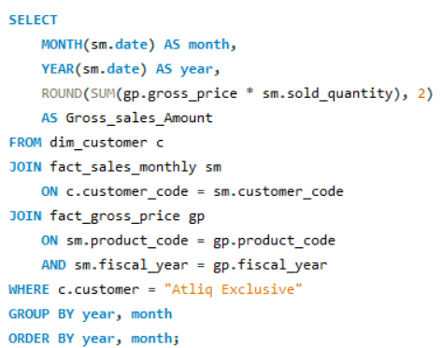
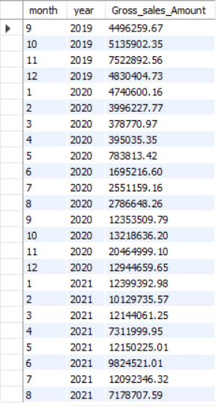
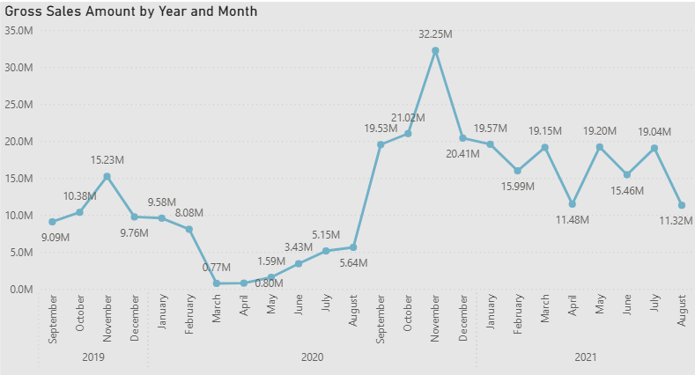
7. Get the complete report of the Gross sales amount for the customer "Atliq Exclusive" for each month.
Output Fields: Month, Year, Gross sales Amount

Slide 11
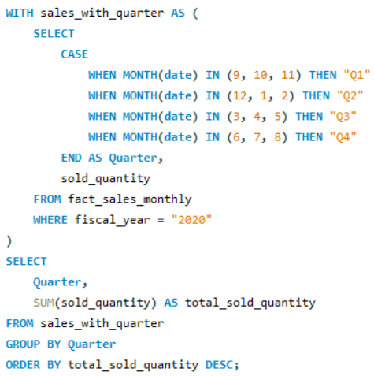
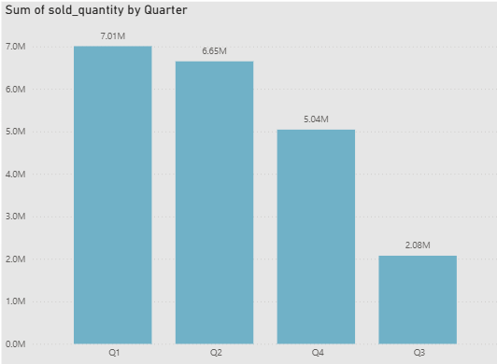
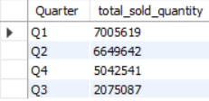
8. In which quarter of 2020 did we get the maximum total_sold_quantity?
Output Fields: Quarter, total_sold_quantity

Slide 12
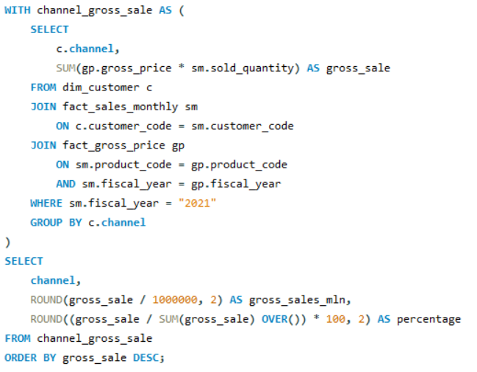
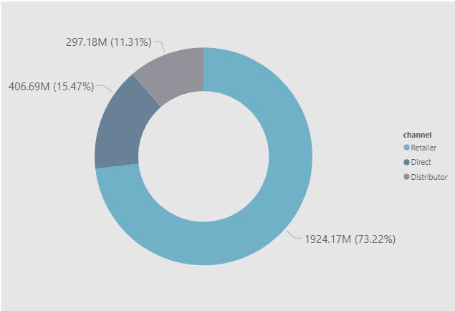
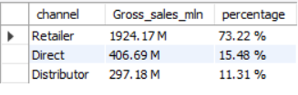
9. Which channel helped to bring more gross sales in the fiscal year 2021 and the percentage of contribution?
Output Fields: channel, gross_sales_mln, percentage

Slide 13
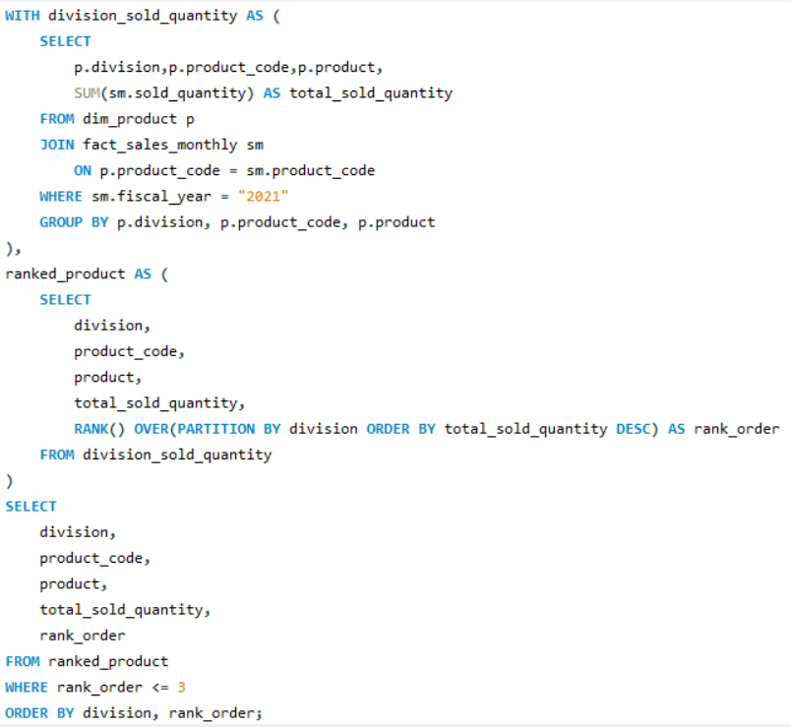
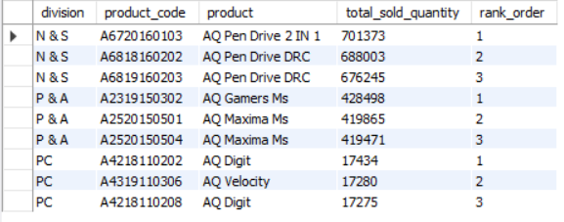
10. Get the Top 3 products in each division that have a high total_sold_quantity in the fiscal_year 2021.
Output Fields: division, product_code, product, total_sold_quantity, rank_order

Slide 14
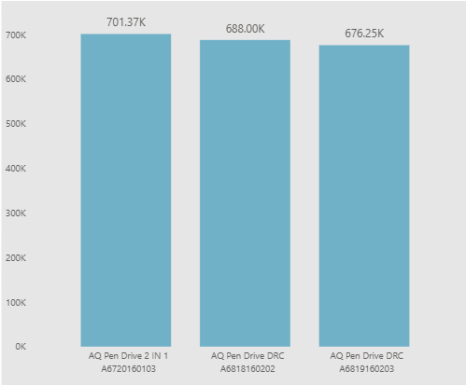
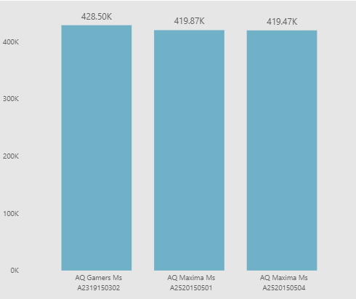
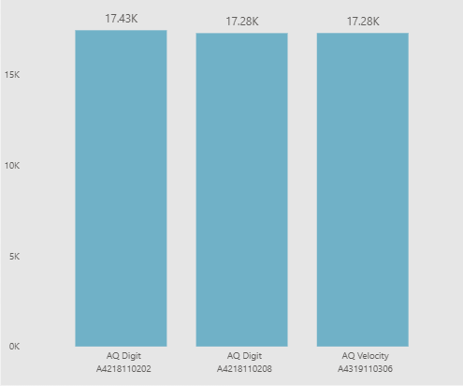
10. Get the Top 3 products in each division that have a high total_sold_quantity in the fiscal_year 2021.
Output Fields: division, product_code, product, total_sold_quantity, rank_order
N & S
P & A
PC

